Slide 1
Subscribe to DeepL Pro to edit this document.
Visit www.DeepL.com/pro for more information.

Slide 2
Service Oriented Architecture (SOA)
Intelligent Infrastructure Design for the Internet of Things
Antonio Navarro

Slide 3
References
B.V. Kumar, P. Narayan, T. Ng, Implementing SOA Using Java EE, Addison-Wesley, 2010.
Mark D. Hansen, SOA Using Java Web Services, Prentice Hall, 2007
Russel Butek, Which style of WSDL should I use?, 2003, https://www.ibm.com/developerworks/library/ws-whichwsdl/
Thomas Erl, SOA Principles of Service Design, Prentice Hall, 2008.

Slide 4
Index
Introduction
Service Oriented Architecture (SOA)
Objectives and benefits of SOA
SOA design principles
SOA or not SOA
Web services
REST Web Services
SOAP web services
SOAP vs. REST
Intelligent Infrastructure Design for IoT - MiOT UCM
Antonio Navarro

Slide 5
Introduction
Today, there are many solutions for business applications with industrial dimensions.
All have advantages and disadvantages
The most important thing is to be clear about when to apply each one.
Intelligent Infrastructure Design for IoT - MiOT UCM
Antonio Navarro

Slide 6
Type of application | Solution | Use of frames | J2EE implementation examples
 |  |  | Pres. | Business | Integration
Corporate | Multilayer architecture | No | JSP | SAs POJOs + transfers | DAOs POJOs
 |  | Yes | JSF | SAs POJOs + entities | JPA
+ Distributed Logic | RPC (Remote Procedure Call) | No | JSP (client) | SAs POJOs + RMI + transfers | DAOs POJOs
 |  | Yes | JSF (client) | Session EJBs + entities | JPA
Heterogeneous platforms | + SOA | No | JSP (client) | SAs POJOs + transfers + JAX WS / JAX RS | DAOs POJOs
 |  | Yes | JSF (client) | Session EJBs JAX WS / JAX RS + entities | JPA
Applicable solution based on application requirements
Intelligent Infrastructure Design for IoT - MiOT UCM
Antonio Navarro

Slide 7
Introduction
We have already seen the multilayer architecture
Remote object invocation in practice is closely linked to implementation platforms.
We will now focus on service-oriented architectures, more independent of the implementation platforms
Intelligent Infrastructure Design for IoT - MiOT UCM
Antonio Navarro

Slide 8
SOA
Service-oriented architecture (SOA) is an architectural model that attempts to improve the efficiency, agility and productivity of an enterprise by placing services as the primary method through which the solution logic is represented.
In principle, the architecture itself should be differentiated from the elements of service-oriented computing, but in many contexts it is used interchangeably.
Intelligent Infrastructure Design for IoT - MiOT UCM
Antonio Navarro

Slide 9
SOA
Two uses of SOA must be distinguished:
As a logic invocation mechanism for external systems, i.e., as an API to be used by the integration layer of another system
In addition, as a logic invocation mechanism for its own internal system
Intelligent Infrastructure Design for IoT - MiOT UCM
Antonio Navarro

Slide 10
Objectives and benefits of SOA
We can list the following:
Increased interoperability
Increase in the federation
Increasing platform diversification options
Greater alignment of business and technology
Increased return on investment
Increased organizational agility
Reduction of ICT burden
Intelligent Infrastructure Design for IoT - MiOT UCM
Antonio Navarro

Slide 11
Objectives and benefits of SOA
Increased interoperability
In this context, interoperability means data sharing between applications.
Exposing an application's services through SOA facilitates such interoperability.
Intelligent Infrastructure Design for IoT - MiOT UCM
Antonio Navarro

Slide 12
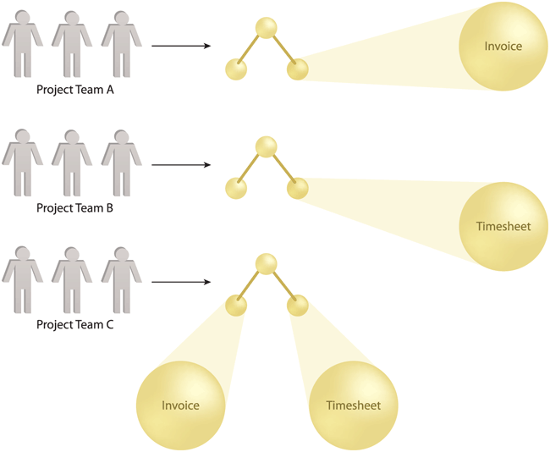
Objectives and benefits of SOA
Increased interoperability in SOA
Intelligent Infrastructure Design for IoT - MiOT UCM
Antonio Navarro

Slide 13
Objectives and benefits of SOA
Increase in the federation
A federated computing environment is one where resources and applications are linked together while maintaining their autonomy and self-governance.
The exposure of services through SOA naturally favors the federation of functionalities.
Intelligent Infrastructure Design for IoT - MiOT UCM
Antonio Navarro

Slide 14
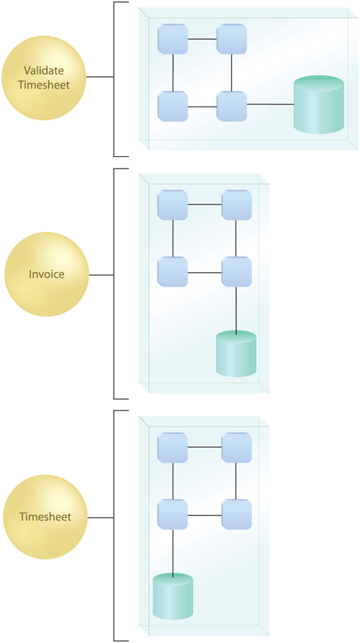
Objectives and benefits of SOA
Services establishing a federated set of encapsulated functionalities
Intelligent Infrastructure Design for IoT - MiOT UCM
Antonio Navarro

Slide 15
Objectives and benefits of SOA
Increasing supplier diversification options
Diversification allows you to choose the best product from each supplier and use them in an integrated manner
SOA naturally allows the use of a vendor regardless of its implementation platform.
Intelligent Infrastructure Design for IoT - MiOT UCM
Antonio Navarro

Slide 16
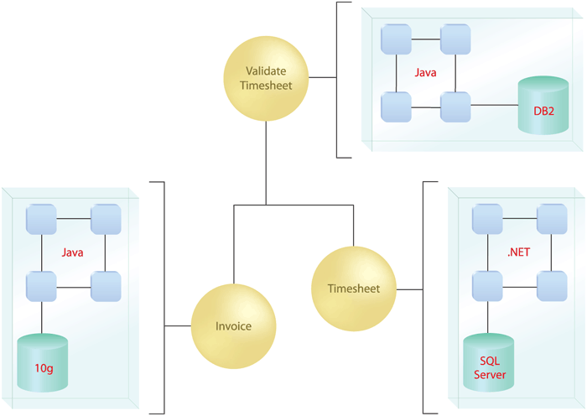
Objectives and benefits of SOA
Services implemented on different platforms
Intelligent Infrastructure Design for IoT - MiOT UCM
Antonio Navarro

Slide 17
Objectives and benefits of SOA
Greater alignment of business and technology
Alignment aims to ensure that the IT system supports a company's changing requirements as quickly as possible.
To the extent that the system is designed around fine-grained services, the evolution of the system will be facilitated, and thus the alignment between business and technology will be facilitated.
Intelligent Infrastructure Design for IoT - MiOT UCM
Antonio Navarro

Slide 18
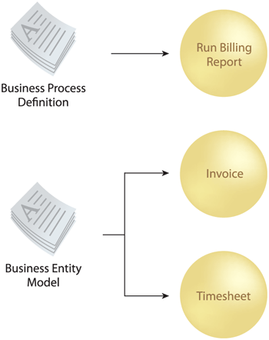
Objectives and benefits of SOA
Fine-grained services favor evolution and hence alignment
Intelligent Infrastructure Design for IoT - MiOT UCM
Antonio Navarro

Slide 19
Objectives and benefits of SOA
Increased return on investment
The higher the return on investment, the higher the profitability of an organization.
The ability to reuse and evolve an SOA solution favors increased profits, despite a higher initial investment.
Intelligent Infrastructure Design for IoT - MiOT UCM
Antonio Navarro

Slide 20
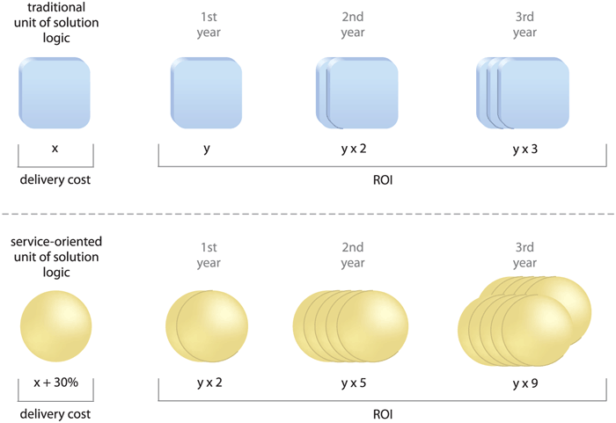
Objectives and benefits of SOA
Comparison of return on investment in classic and SOA solutions
Intelligent Infrastructure Design for IoT - MiOT UCM
Antonio Navarro

Slide 21
Objectives and benefits of SOA
Increased organizational agility
Agility is the efficiency with which an organization can respond to change.
As long as there is a good IT support and alignment between business and system, things that favor SOA, the organization will be more agile.
Intelligent Infrastructure Design for IoT - MiOT UCM
Antonio Navarro

Slide 22
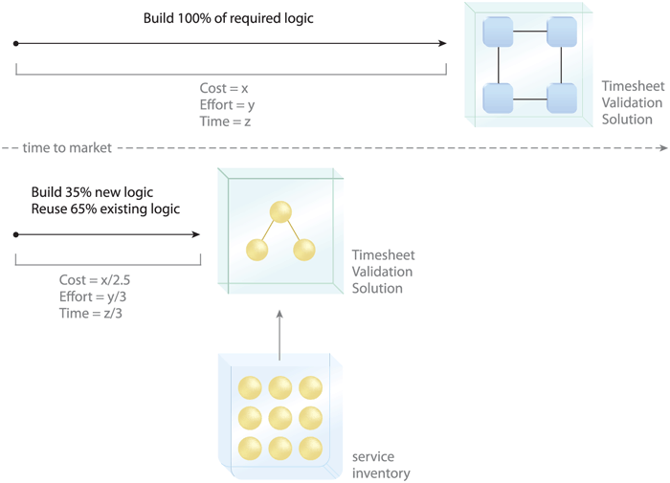
Objectives and benefits of SOA
Comparison of changeover time in a traditional and SOA application
Intelligent Infrastructure Design for IoT - MiOT UCM
Antonio Navarro

Slide 23
Objectives and benefits of SOA
Reduction of the ICT burden
The lower the load of any component of a company, the higher the sales.
Service-oriented architecture allows for a more agile ICT department that reduces the burden on the organization.
Intelligent Infrastructure Design for IoT - MiOT UCM
Antonio Navarro

Slide 24
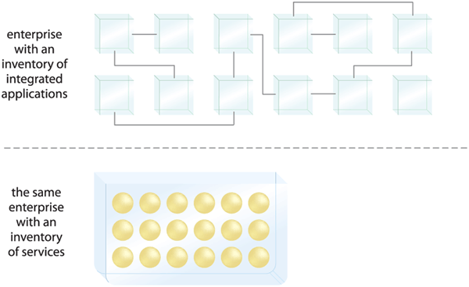
Objectives and benefits of SOA
Service organization allows for less costly IT departments
Intelligent Infrastructure Design for IoT - MiOT UCM
Antonio Navarro

Slide 25
SOA design principles
There are a number of principles when designing services:
Standard service contract
Low service coupling
Service abstraction
Service reusability
Service autonomy
Stateless services
Ability to find services
Ability to compose services
Intelligent Infrastructure Design for IoT - MiOT UCM
Antonio Navarro

Slide 26
SOA design principles
Ability to find the service
Service Componentization
Standard service contract
Services express their purpose and capabilities through a service contract. For example:
WSDL
XML Schema
Description WS-Policy
This is the most important principle
Intelligent Infrastructure Design for IoT - MiOT UCM
Antonio Navarro

Slide 27
SOA design principles
Low coupling of services
Coupling is the level of connection or relationship between two elements.
Low coupling of services promotes no dependency between services, nor access to service implementations by jumping their interface.
Service abstraction
This principle promotes concealing as many details of the service implementation as possible.
In other words, it promotes minimal and abstract interfaces
Intelligent Infrastructure Design for IoT - MiOT UCM
Antonio Navarro

Slide 28
SOA design principles
Reusability of services
This principle promotes the positioning of services as business resources independent of specific functional contexts.
Thus, the services are useful for more than one purpose
Autonomy of services
This principle determines that services must be able to perform their functionality consistently and reliably.
For this, the implementation of such services must have a significant degree of control over its environment and resources.
Intelligent Infrastructure Design for IoT - MiOT UCM
Antonio Navarro

Slide 29
SOA design principles
Stateless services
Managing excessive status information can compromise the availability of a service and limit its potential for scale.
Therefore, the services should only have status in very specific and determined cases.
Intelligent Infrastructure Design for IoT - MiOT UCM
Antonio Navarro

Slide 30
SOA design principles
Ability to find services
To increase ROI and leverage services, services should make clear what their functionality is:
Purpose
Capabilities
Resource constraints
Such functionality should be made clear regardless of the existence of mechanisms such as service registries.
Intelligent Infrastructure Design for IoT - MiOT UCM
Antonio Navarro

Slide 31
SOA design principles
Ability to compose services
As the sophistication of SOA solutions grows, so does the complexity of service composition configurations.
Therefore, the ability to compose services is essential in advanced applications.
Intelligent Infrastructure Design for IoT - MiOT UCM
Antonio Navarro

Slide 32
SOA design principles
The above principles lack the concept of interoperability.
It has not been made explicit, as it is assumed to be a fundamental requirement of SOA and each of the above principles.
Intelligent Infrastructure Design for IoT - MiOT UCM
Antonio Navarro

Slide 33
SOA design principles
Consistent application of these eight design principles produces designs with:
Improved consistency in the representation of functionality and data
Reduced dependencies between logical solution units
Reduced knowledge of logic design and its implementation
Increased ability to reuse a logical solution element for multiple purposes
Intelligent Infrastructure Design for IoT - MiOT UCM
Antonio Navarro

Slide 34
SOA design principles
Increased opportunity to combine logical solution units in different configurations
Higher level of behavioral prediction
Increased availability and scalability
Increased knowledge of available logical solutions
Intelligent Infrastructure Design for IoT - MiOT UCM
Antonio Navarro

Slide 35
SOA or not SOA
There are some problems that non-SOA architectures can present:
There may be redundant functionality
This makes the development process inefficient.
It causes the existence of unnecessary functionality in the company.
This leads to heterogeneous platforms, complex infrastructures and convoluted architectures.
Integration becomes a constant challenge
Intelligent Infrastructure Design for IoT - MiOT UCM
Antonio Navarro

Slide 36
SOA or not SOA
The SOA architecture has several advantages:
Increased amount of solution-independent logic
Less application-specific logic
Reduction in logic volume
Inherent interoperability
Intelligent Infrastructure Design for IoT - MiOT UCM
Antonio Navarro
Intelligent Infrastructure Design for IoT - MiOT UCM
Antonio Navarro

Slide 37
SOA or not SOA
Increased amount of solution-independent logic
Within an SOA solution, units of logic (services) encapsulate functionality that is not specific to an application or business service.
These elements are reusable TICS elements that are independent of the solution.
Intelligent Infrastructure Design for IoT - MiOT UCM
Antonio Navarro

Slide 38
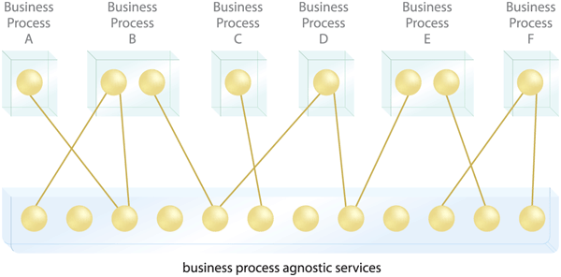
SOA or not SOA
Services as reusable logic elements
Intelligent Infrastructure Design for IoT - MiOT UCM
Antonio Navarro

Slide 39
SOA or not SOA
Less application-specific logic
By making services that are not specific to an application or business, the amount of application-specific logic is decreased.
This blurs the concept of independent application.
Intelligent Infrastructure Design for IoT - MiOT UCM
Antonio Navarro

Slide 40
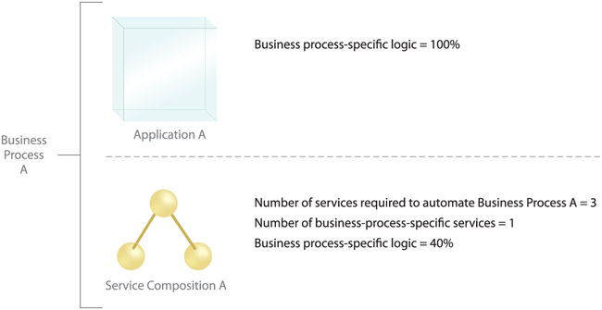
SOA or not SOA
Solution-specific logic reduction
Intelligent Infrastructure Design for IoT - MiOT UCM
Antonio Navarro
Intelligent Infrastructure Design for IoT - MiOT UCM
Antonio Navarro

Slide 41
SOA or not SOA
Reduction in logic volume
The volume of the solution logic is reduced as services are shared and reused by different business processes.
Intelligent Infrastructure Design for IoT - MiOT UCM
Antonio Navarro

Slide 42
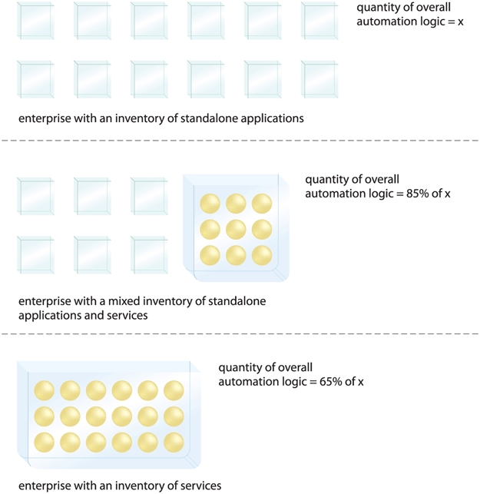
SOA or not SOA
Logic volume in classic, mixed and SOA applications
Intelligent Infrastructure Design for IoT - MiOT UCM
Antonio Navarro

Slide 43
SOA or not SOA
Inherent interoperability
SOA solutions involve aligned logic solutions
Thus, service contracts and their underlying data models provide a mechanism to increase interoperability.
Intelligent Infrastructure Design for IoT - MiOT UCM
Antonio Navarro

Slide 44
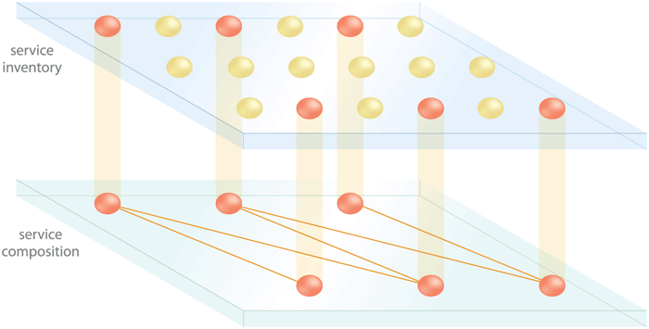
SOA or not SOA
Consistent set of services increases interoperability and composability
Intelligent Infrastructure Design for IoT - MiOT UCM
Antonio Navarro
Intelligent Infrastructure Design for IoT - MiOT UCM
Antonio Navarro

Slide 45
SOA or not SOA
SOA architecture also presents a number of challenges:
Increased design complexity
Need for design and architectural standards
Pre-listing of all services prior to their implementation
May hinder the application of agile methodologies.
Forces the presence of an authority in the management of services
Therefore, an SOA solution should only be applied when strictly necessary.
Intelligent Infrastructure Design for IoT - MiOT UCM
Antonio Navarro

Slide 46
Web services
SOA is a generic architecture independent of concrete implementations.
CORBA can be an SOA implementation
It is common to speak of web services as a mechanism for SOA implementation.
Intelligent Infrastructure Design for IoT - MiOT UCM
Antonio Navarro

Slide 47
Web services
There are several definitions, but I am not convinced by any of them
I would say that a web service is an element of logic invocable over the network and whose client only knows the type of the input information output, and the implemented functionality, i.e., it does not know its implementation platform
Intelligent Infrastructure Design for IoT - MiOT UCM
Antonio Navarro

Slide 48
Web services
There is a first generation of web services characterized by the use of:
Web Services Description Language (WSDL)
Simple Object Access Protocol (SOAP)
Universal Description, Discovery and Integration (UDDI)
WS-I Basic Profile
Intelligent Infrastructure Design for IoT - MiOT UCM
Antonio Navarro

Slide 49
Web services
Service Registration (UDDI)
discover and retrieve (WSDL)
publication
(WSDL)
Service Provider
Applicant for the service
Message exchange (SOAP)
First generation of web services
Intelligent Infrastructure Design for IoT - MiOT UCM
Antonio Navarro

Slide 50
Web services
There is a second generation of web services based on extensions to the first generation web services. Among others:
WS-Security Specification and Frameworks
WS-Addressing Specification
WS-Reliable Messaging Specifications
WS-Business Process Execution Language
WS-Choreography Definition Language
WS-Metadata Exchange Specifications
Intelligent Infrastructure Design for IoT - MiOT UCM
Antonio Navarro

Slide 51
Web services
There are two implementations of web services:
REST Web Services
SOAP web services
 | REST | SOAP
Message format | XML, JSON | XML within SOAP
Interface definition | it is not necessary | WSDL
Transportation | HTTP | HTTP, JMS, FTP, etc.
Differences between REST and SOAP web services
Intelligent Infrastructure Design for IoT - MiOT UCM
Antonio Navarro

Slide 52
REST Web Services
REST web services are based on Roy Fielding's Ph.
REST-style, or RESTful, web services are referred to as RESTful
They are based on a series of principles:
RESTful services are stateless. Each request from the client to the server must contain all the information necessary to understand the request, and cannot take advantage of any context stored on the server.
Intelligent Infrastructure Design for IoT - MiOT UCM
Antonio Navarro

Slide 53
REST Web Services
Web services have a common interface. This usually means that the only operations allowed are those provided by the HTTP protocol: GET, POST, PUT and DELETE.
REST architectures are built on resources that are uniquely identified by URIs. Thus, each URI represents a different function and, by extension, a different data.
REST components manipulate resources by exchanging representations of them. Thus, information is exchanged in XML format.
Intelligent Infrastructure Design for IoT - MiOT UCM
Antonio Navarro

Slide 54
REST Web Services
Example of REST web service invocation:
URL url = new URL("http://localhost:8080/RESTplano/saluda ? firstname=Charlton&lastname=Heston");
HttpURLConnection with = (HttpURLConnection) url.openConnection();
con.setRequestMethod("GET");
InputStream in = con.getInputStream();
byte[] b = new byte[1024];
int result = in.read(b);
while (result != -1) {
System.out.write(b,0,result);
result =in.read(b); }
in.close();
con.disconnect();
Intelligent Infrastructure Design for IoT - MiOT UCM
Antonio Navarro

Slide 55
REST Web Services
Example of REST web service implementation:
public class Saluda extends HttpServlet {
public void doGet(HttpServletRequest req, HttpServletResponse res) throws ServletException, IOException {
String name = req.getParameter("name");
String lastName= req.getParameter("lastName");
GreetingWSB greetingWSB= new GreetingWSB();
String reply= greetingWSB.greet(firstname, lastname); res.getWriter(). write(reply);
}
}
Intelligent Infrastructure Design for IoT - MiOT UCM
Antonio Navarro

Slide 56
REST Web Services
The above example does not use Java-specific frameworks for the implementation of REST web services, such as:
JAX-RS (Java API for RESTful Web Services)
JAXB (Java Architecture for XML Binding)
Intelligent Infrastructure Design for IoT - MiOT UCM
Antonio Navarro

Slide 57
SOAP web services
SOAP web services use SOAP to
Invoking web services described through WSDL interfaces
Encode the input and output parameters of the invoked service in XML format.
They require a mechanism to translate:
Service requests in logic elements
Parameters of a programming language in other languages
Intelligent Infrastructure Design for IoT - MiOT UCM
Antonio Navarro

Slide 58
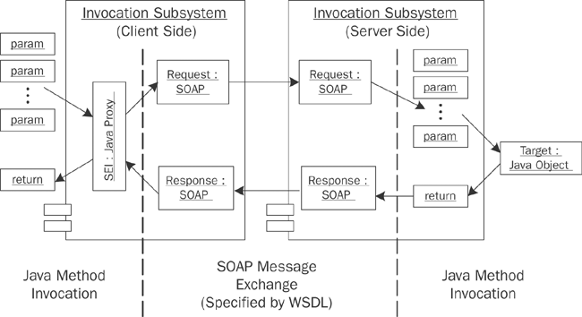
SOAP web services
SOAP web services invocation and response
Intelligent Infrastructure Design for IoT - MiOT UCM
Antonio Navarro

Slide 59
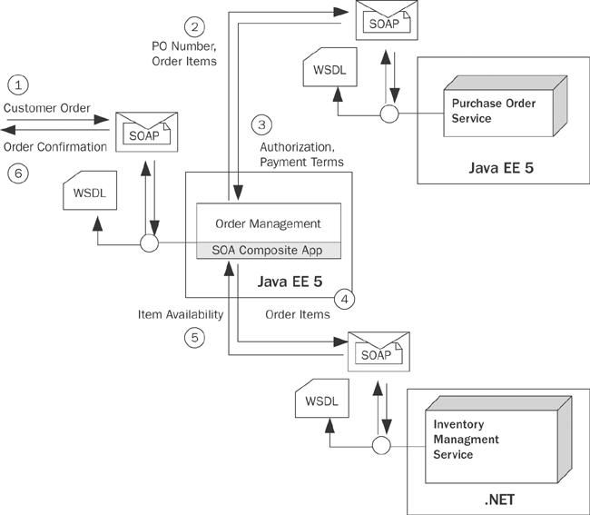
SOAP web services
Intelligent Infrastructure Design for IoT - MiOT UCM
Antonio Navarro
Example of an application based on SOAP web services

Slide 60
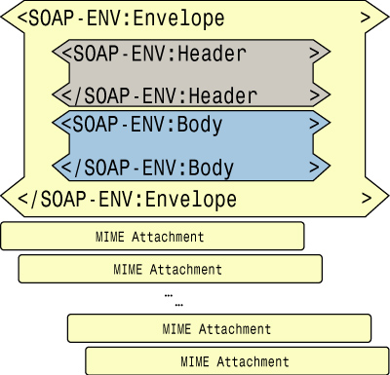
SOAP web services
The basic structure of a SOAP message is:
Basic structure of a SOAP message
Intelligent Infrastructure Design for IoT - MiOT UCM
Antonio Navarro

Slide 61
SOAP web services
Where:
Envelope: it is the root element. It stores namespace and coding style information.
Header: optional, but not usually omitted. They provide services to the cargo carried in the Body element.
Body: is mandatory. Contains the payload of the SOAP message to be processed by the destination endpoint.
Intelligent Infrastructure Design for IoT - MiOT UCM
Antonio Navarro

Slide 62
SOAP web services
SOAP request example
<env1:Envelope xmlns:env1="http://schemas.xmlsoap.org/soap/envelope">
<env1:Body>
< getord:getOrdersDates xmlns:getord="http://www.example.com/oms/getorders"> <getord:startDate>2005-11-19</getord:startDate>
<getord:endDate>2005-11-22</getord:endDate>
</getord:getOrdersDates>.
</env1:Body>
</env1:Envelope>
Intelligent Infrastructure Design for IoT - MiOT UCM
Antonio Navarro

Slide 63
SOAP web services
Example of SOAP response
<env1:Envelope xmlns:env1="http://schemas.xmlsoap.org/soap/envelope">
<env1:Body>
< getord:getOrdersDatesResponse
xmlns:getord="http://www.example.com/oms/getorders">
< Orders xmlns="http://www.example.com/oms"
xmlns:xsi="http://www.w3.org/2001/XMLSchema-instance"
xsi:schemaLocation="http://www.example.com/oms
http://soabook.com/example/oms/orders.xsd">
Intelligent Infrastructure Design for IoT - MiOT UCM
Antonio Navarro

Slide 64
SOAP web services
< Order>
< OrderKey>ENT1234567</OrderKey>.
< OrderHeader>
<SALES_ORG>NE</SALES_ORG>.
<PURCH_DATE>2005-11-20</PURCH_DATE>
<CUST_NO>ENT0072123</CUST_NO>
<PYMT_METH>PO</PYMT_METH>.
<PURCH_ORD_NO>PO-72123-0007</PURCH_ORD_NO>
<WAR_DEL_DATE>2006-12-20</WAR_DEL_DATE>
</OrderHeader>
………………………………………………………
Intelligent Infrastructure Design for IoT - MiOT UCM
Antonio Navarro

Slide 65
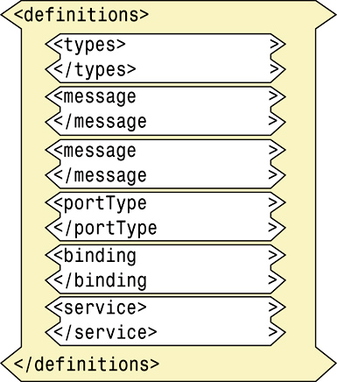
SOAP web services
The structure of a WSDL interface is:
Intelligent Infrastructure Design for IoT - MiOT UCM
Antonio Navarro
WSDL interface structure

Slide 66
SOAP web services
Where:
definitions: is the root element and contains the elements that define a web service.
types: acts as a container for data type definitions using XML schema definitions. These schemas define the data types of the information using message elements.
Intelligent Infrastructure Design for IoT - MiOT UCM
Antonio Navarro

Slide 67
SOAP web services
message: these elements characterize abstract typed definitions of the exchanged data. These elements reference the data types defined in types
portType: this element describes one or more set of abstract operations supported by one or more endpoints. It uses operation elements to describe these operations, which refer to the values defined in message to characterize the function parameters.
Intelligent Infrastructure Design for IoT - MiOT UCM
Antonio Navarro

Slide 68
SOAP web services
binding: specifies a particular protocol for transport binding and a data format specification for a portType element. (Butek, 2005) is a good guide.
service: identifies the web service in its name attribute. It models multiple web services through a collection of port elements, which indicate endpoints as a combination of transport bindings and network addresses.
port: provides the name and location of the system on which the web service is located. Models an individual web service
Intelligent Infrastructure Design for IoT - MiOT UCM
Antonio Navarro

Slide 69
SOAP web services
Example of WSDL interface:
<? xml version="1.0" encoding="UTF-8"?>
< wsdl:definitions name="SumaImplementationService" targetNamespace="http://servicioAplicacion.negocio/" xmlns:wsdl="http://schemas.xmlsoap.org/wsdl/" xmlns:tns="http://servicioAplicacion.negocio/" xmlns:xsd="http://www.w3.org/2001/XMLSchema" xmlns:soap="http://schemas.xmlsoap.org/wsdl/soap/">
< wsdl:types>
< schema xmlns="http://www.w3.org/2001/XMLSchema">
<import namespace="http://servicioAplicacion.negocio/" schemaLocation="suma_schema1.xsd"/>
</schema>
</wsdl:types>
Intelligent Infrastructure Design for IoT - MiOT UCM
Antonio Navarro

Slide 70
SOAP web services
< wsdl:message name="add">
< wsdl:part name="parameters" element="tns:sum">
</wsdl:part>
</wsdl:message>
< wsdl:message name="addResponse">
< wsdl:part name="parameters" element="tns:sumResponse">
</wsdl:part>
</wsdl:message>
Intelligent Infrastructure Design for IoT - MiOT UCM
Antonio Navarro

Slide 71
SOAP web services
< wsdl:portType name="Sum">
< wsdl:operation name="add">
< wsdl:input name="sum" message="tns:sum">
</wsdl:input>
< wsdl:output name="sumarResponse" message="tns:sumarResponse">
</wsdl:output>
</wsdl:operation>
</wsdl:portType>
Intelligent Infrastructure Design for IoT - MiOT UCM
Antonio Navarro

Slide 72
SOAP web services
< wsdl:binding name="SumaImplementationServiceSoapBinding" type="tns:Sum">
< soap:binding style="document" transport="http://schemas.xmlsoap.org/soap/http"/>
< wsdl:operation name="add">
< soap:operation soapAction="" style="document"/>
< wsdl:input name="sum">
< soap:body use="literal"/>
</wsdl:input>
< wsdl:output name="addResponse">
< soap:body use="literal"/>
</wsdl:output>
</wsdl:operation>
</wsdl:binding>
Intelligent Infrastructure Design for IoT - MiOT UCM
Antonio Navarro

Slide 73
SOAP web services
< wsdl:service name="SumAddImplementationService">
< wsdl:port name="SumaImplementacionPort" binding="tns:SumaImplementacionServiceSoapBinding">
< soap:address location="http://localhost:55555/servicioSuma/services/SumaImplementacionPort"/>
</wsdl:port>
</wsdl:service>
</wsdl:definitions>
Intelligent Infrastructure Design for IoT - MiOT UCM
Antonio Navarro

Slide 74
SOAP web services
Example of WSDL interface
<? xml version="1.0" encoding="UTF-8"?>
< wsdl:definitions name="CalculoImplementacionService" targetNamespace="http://servicioAplicacion.negocio/" xmlns:wsdl="http://schemas.xmlsoap.org/wsdl/" xmlns:tns="http://servicioAplicacion.negocio/" xmlns:xsd="http://www.w3.org/2001/XMLSchema" xmlns:soap="http://schemas.xmlsoap.org/wsdl/soap/">
< wsdl:types>
< schema xmlns="http://www.w3.org/2001/XMLSchema">
< import namespace="http://servicioAplicacion.negocio/" schemaLocation="calculo_schema1.xsd"/>
</schema>
</wsdl:types>
Intelligent Infrastructure Design for IoT - MiOT UCM
Antonio Navarro

Slide 75
SOAP web services
< wsdl:message name="add">
< wsdl:part name="parameters" element="tns:sum">
</wsdl:part>
</wsdl:message>
< wsdl:message name="subtract">
< wsdl:part name="parameters" element="tns:subtract">
</wsdl:part>
</wsdl:message>
Intelligent Infrastructure Design for IoT - MiOT UCM
Antonio Navarro

Slide 76
SOAP web services
< wsdl:message name="addResponse">
< wsdl:part name="parameters" element="tns:sumResponse">
</wsdl:part>
</wsdl:message>
< wsdl:message name="subtarResponse">
< wsdl:part name="parameters" element="tns:subtarResponse">
</wsdl:part>
</wsdl:message>
Intelligent Infrastructure Design for IoT - MiOT UCM
Antonio Navarro

Slide 77
SOAP web services
< wsdl:portType name="Calculation">
< wsdl:operation name="subtract">
< wsdl:input name="subtract" message="tns:subtract">
</wsdl:input>
< wsdl:output name="subtarResponse" message="tns:subtarResponse">
</wsdl:output>
</wsdl:operation>
< wsdl:operation name="add">
< wsdl:input name="sum" message="tns:sum">
</wsdl:input>
< wsdl:output name="sumarResponse" message="tns:sumarResponse">
</wsdl:output>
</wsdl:operation>
</wsdl:portType>
Intelligent Infrastructure Design for IoT - MiOT UCM
Antonio Navarro

Slide 78
SOAP web services
< wsdl:binding name="CalculationImplementationServiceSoapBinding" type="tns:Calculation">
< soap:binding style="document" transport="http://schemas.xmlsoap.org/soap/http"/>
< wsdl:operation name="subtract">
< soap:operation soapAction="" style="document"/>
< wsdl:input name="subtract">
< soap:body use="literal"/>
</wsdl:input>
< wsdl:output name="subtractResponse">
< soap:body use="literal"/>
</wsdl:output>
</wsdl:operation>
Intelligent Infrastructure Design for IoT - MiOT UCM
Antonio Navarro

Slide 79
SOAP web services
< wsdl:operation name="add">
< soap:operation soapAction="" style="document"/>
< wsdl:input name="sum">
< soap:body use="literal"/>
</wsdl:input>
< wsdl:output name="addResponse">
< soap:body use="literal"/>
</wsdl:output>
</wsdl:operation>
</wsdl:binding>
Intelligent Infrastructure Design for IoT - MiOT UCM
Antonio Navarro

Slide 80
SOAP web services
< wsdl:service name="CalculoImplementacionService">
< wsdl:port name="CalculoImplementacionPort" binding="tns:CalculoImplementacionServiceSoapBinding">
< soap:address location="http://localhost:55555/servicioCalculo/services/CalculoImplementacionPort"/>
</wsdl:port>
</wsdl:service>
</wsdl:definitions>
Intelligent Infrastructure Design for IoT - MiOT UCM
Antonio Navarro

Slide 81
SOAP vs. REST
This is one of the most frequently asked questions in enterprise applications.
The use of specific frameworks has brought the ease of use of REST much closer to SOAP, however it is easier to use SOAP services than REST, as long as the client language allows or facilitates it.
Despite the use of frameworks, the SOAP middleware layer is more burdensome to applications than REST.

Slide 82
SOAP vs. REST
Depending on whether REST is used (orthodoxly or flexibly), REST can perform only four types of operations or many. SOAP, it can always perform many
SOAP and REST have transport layer (point to point) security using HTTPS
SOAP has application layer security (end to end) and REST does not. However, it puts a lot of overhead on the server
SOAP has distributed transactions and REST does not.

Slide 83
Service Oriented Architecture (SOA)
Intelligent Infrastructure Design for the Internet of Things
Antonio Navarro

